Slide 1


Hotel Management System
FINAL PROJECT - Group 8

Slide 2






Our Team
NGUYỄN ANH KHOA
NGUYỄN HUỲNH PHÚ ANH
NGUYỄN HOÀNH ANH TÂN
NGUYỄN TRUNG NAM
HOÀNG HẢO HIỆP
519H0303
520H0001
520H0417
519H0321
519H0160

Slide 3


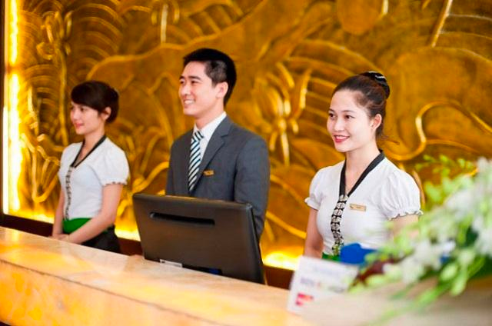
Welcome Project
Hotels Manager Hotel
The purpose of the hotel booking system is to automate the existing manual system by the help of computerized equipment and full fledged computer software, fulfilling their requirement, so that their valuable information can be stored for a longer period with easy accessing and manipulating of the same . The required software and hardware are easily available and easy to work with. This proposes that efficiency of hotel organizations could be improved by integrating service-oriented operations service-oriented operations with project management principles. Such integration would instill innovation, proactive attitudes and regulated risk-taking needed to pursue ongoing improvement and proactive response to change. By managing each change as a project, embedded in smoothly running operations, hotels would extend their life span by continuously reinventing themselves.

Slide 4


Table of Content
Ginyard International Co.
1. Introducing
2. Project Management Plan
2.1 Project Organization
2.2 Life Cycle Model Used
2.3 Risk Analysis
2.4. Hardware and Software Resource Requirements
3. Requirement Specifications
3.1 Functional requirements
3.2 Use case model
4. Architecture
5. Design

Slide 5




2. Project Management Plan
2.1 Project Organization
Meeting: 18 hours in a week via google meet
1.
draw diagram
2.
Make database
3.
Coding function
4.
Writing report
^^

Slide 6
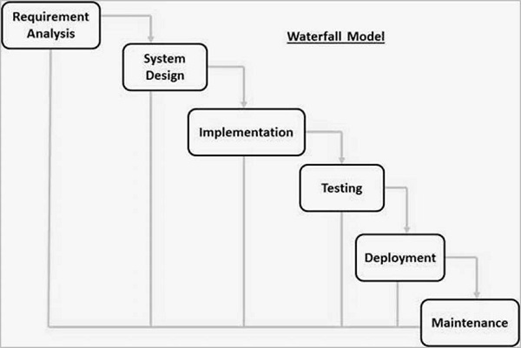
2.2 Life Cycle Model Used
REQUIREMENT GATHERING AND ANALYSIS
During this phase, all potential system requirements are captured and documented in a requirement specification document.
SYSTEM DESIGN
This phase researches the requirement specifications from the first phase and prepares the system design. This system design aids in the specification of hardware and system requirements, as well as the definition of the overall system architecture.
IMPLEMENTATION
The system is first developed in small programs called units, with input from the system design, and then integrated in the next phase. Unit Testing is the process by which each unit is developed and tested for functionality.
INTEGRATION AND TESTING
After each unit has been tested, all of the units developed during the implementation phase are integrated into a system. Following integration, the entire system is tested for flaws and failures.
Figure 2.1: Waterfall Model

Slide 7
2.2 Life Cycle Model Used
DEPLOYMENT OF SYSTEM
Following the completion of functional and non-functional testing, the product is deployed in the customer environment or released to the market.
MAINTENANCE
There are a few issues that arise in the client environment. Patches are released to address these issues. In order to improve the product, newer versions are released. Maintenance is performed in order to implement these changes in the customer environment.
Figure 2.1: Waterfall Model

Slide 8
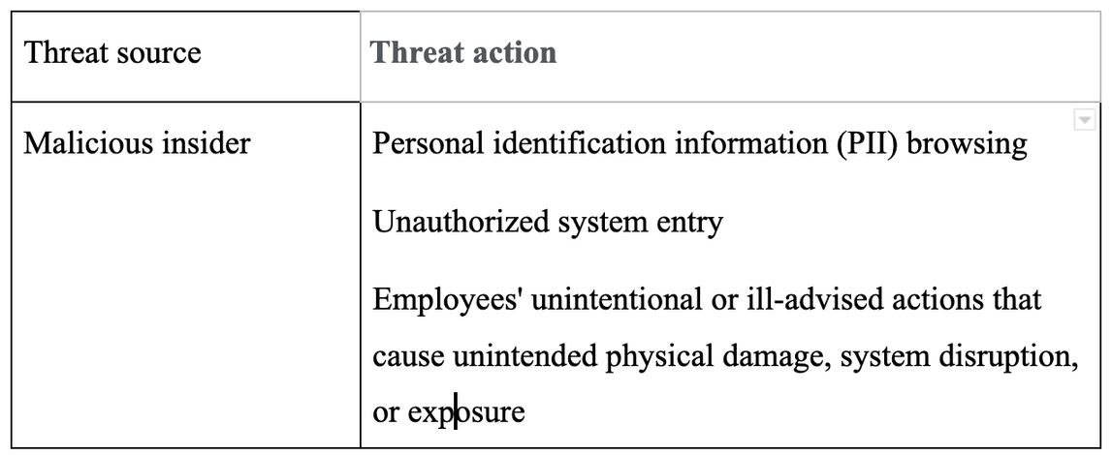
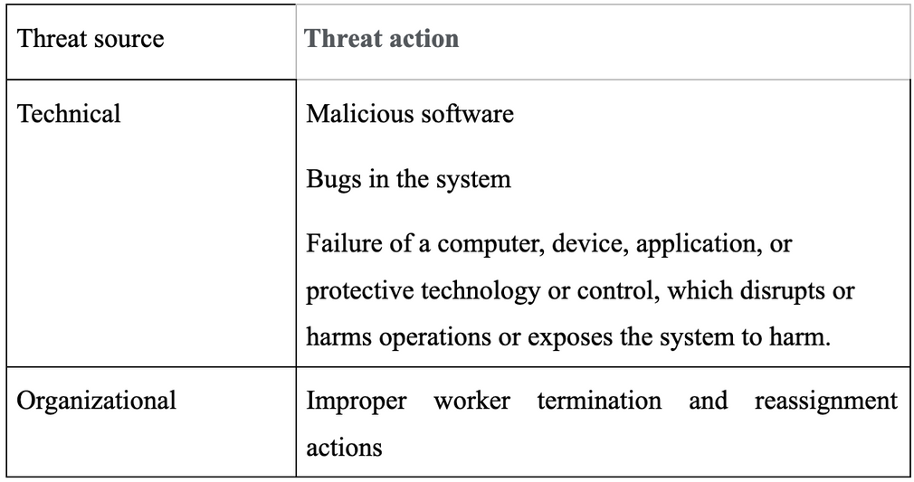
2.3 Risk Analysis
Table 2.1: Risk Analysis

Slide 9



Software
A set of programs associated with the operation of a computer is called software. Software is the part of the computer system, which enables the user to interact with several physical hardware devices. The minimum software requirement specifications for developing this project are as follows:
Operating System : Windows 11/10, Linux, MacOS.
Presentation layer : C#, CSS, HTML
Database : SQL Server
Presentation : Power Point
Tool code: VS Code
Documentation Tools : Google docs, word
2.4. Hardware and Software Resource Requirements
Hardware
The collection of internal electronic circuits and external physical devices used in building a computer is called the Hardware.
The minimum hardware requirement specifications for developing this project are as follows:
Processor : Standard processor with a speed of 1.6 GHz
RAM : 256 MB RAM or more
Hard Disk : 20 GB or more Monitor : Standard color monitor

Slide 10

3. Requirement Specifications
Password
In this module, this website is for multiple users. If a User enters a password and the software checks its validity. If the password is valid then option is given to change the password, otherwise “Invalid User/ Password” message is displayed. There is an option for password recovery, log out, login, new users sign in. The Administrator can also update changes in the site after login
3.1 Functional requirements

Slide 11
CREATING A NEW ENTITY (HOTEL, ROOM, CUSTOMERS,MEMBERS ETC.)
FUNCTION CHECKOUT_CUSTOMER()
This function is used to checkout the customer details from the database. When the user inputs his room number, the same room number will be checked in the database, if the room number is matched in the database, then the customer will be checkout from the database and transferred the record of the checkout to another table of database so that the Hotel Management has the record of customers who have check-out to fulfill his legal liabilities.
This is used to add new employee details, delete entity details and view the details. In that screen, the automatic item is created. In this function, whenever a new entity is required to be added the corresponding forms are opened and the database is manipulated to check whether the data is already existing or not. If it already exists, then it prompts “Entry already existing” and if not then the data is entered with the various validation checks.
FUNCTION GENERATE_BILL()
FUNCTION NEW_ROOM()
When any customer checks-out, his/her bill is generated automatically by calculated check-out date minus check-in date and getting multiplied by daily room charge plus other charges and the bill has to be saved in the table in the database.
This is the function used to open a new room for a customer so that he/she can assign a separate room . In that screen, the automatic room number is created. After opening a new room for the customer, finally a room is assigned to a customer and the room records are appended in the data file.
FUNCTION DISPLAY_RECORD()
FUNCTION CHECKIN_CUSTOMER()
This function is used to admit a customer in our Hotel after entering his all personal details like Name, Address, Phone, Sex and then he/she is assigned a room from NEW_ROOM() function.
This function is used to display all the transactions including the customer name, address, phone, bed number, and doctor assigned to him/her on the screen. This is a global report to display all the transaction records in the screen

Slide 12
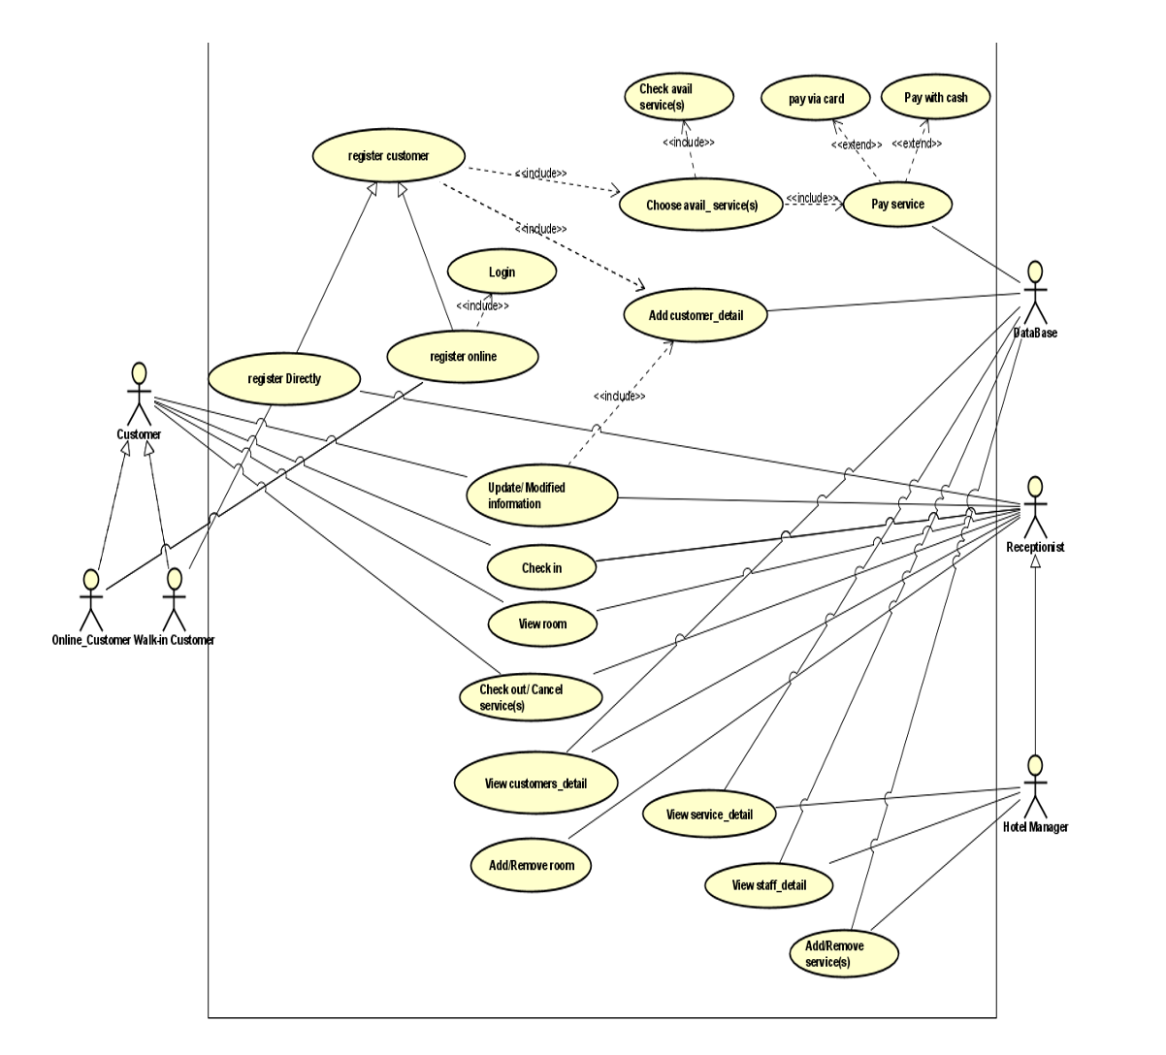
3.2 Use case model
Textual Description for each use case
staff will perform the reservation tasks: services, adding customer information
manage the list of available rooms, check-in list
Perform customer check-out and payment

Slide 13
Ginyard International Co.
4. Architecture
Architectural style(s) used
The three most prevalent styles of software architecture are data-centric style, layered style, and object-oriented style.
Architectural model
Generic model: These models are abstractions derived from a number of real systems and encapsulated the characteristics of these systems. This type of model usually follows a bottom-up approach.

Slide 14
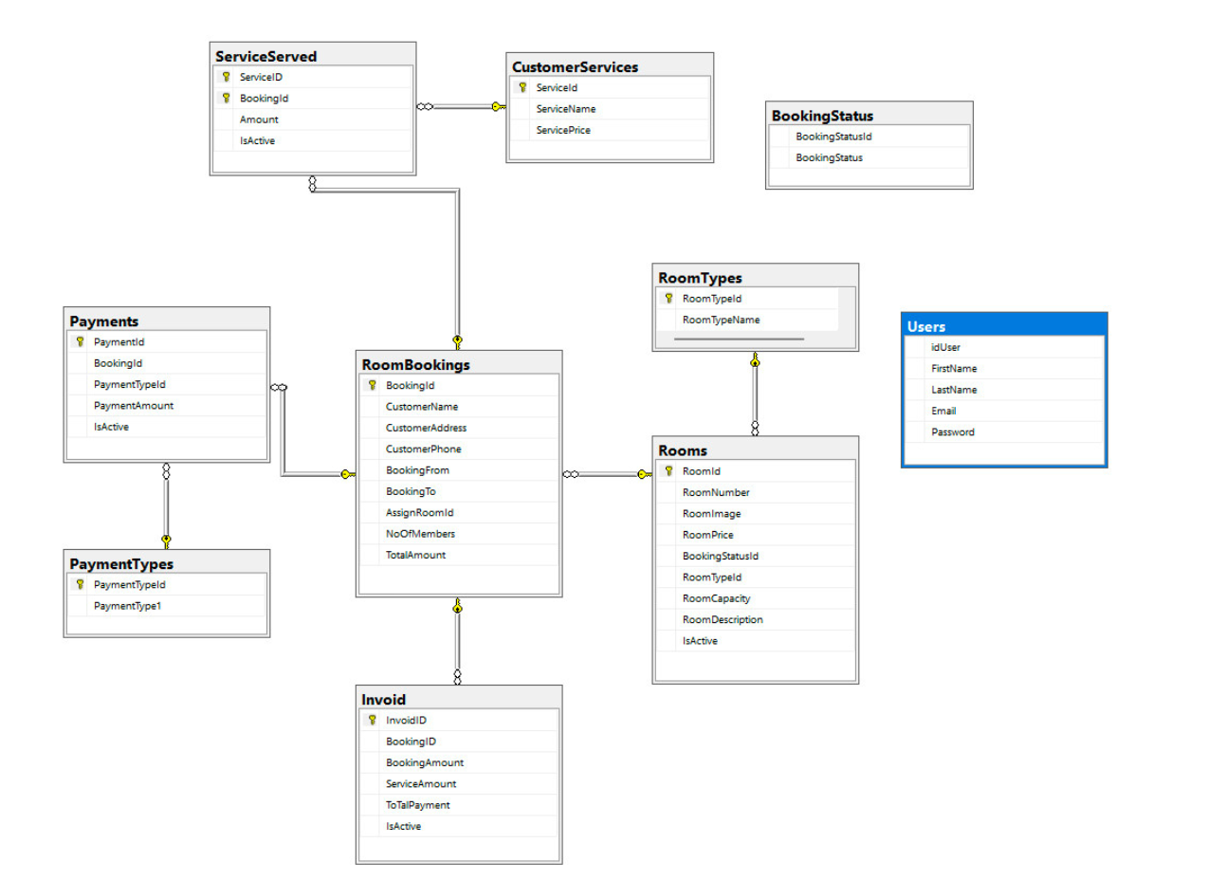
5. Degign
Database design

Slide 15
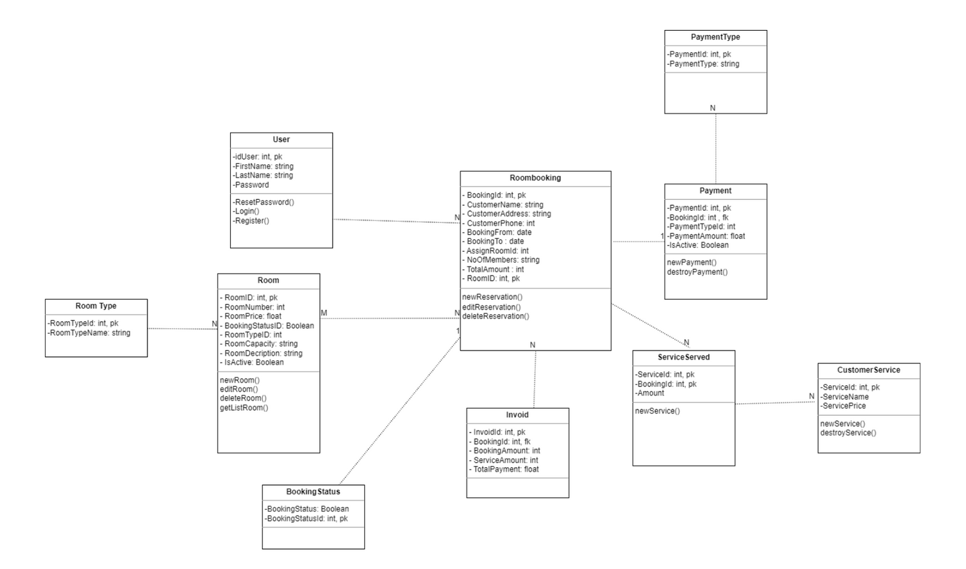
Static model – class diagrams
A class diagram describes the static structure of the symbols in your new system. It is a graphic presentation of the static view that shows a collection of declarative (static) model elements, such as classes, types, and their contents and relationships. Classes are arranged in hierarchies sharing common structure and behavior, and are associated with other classes

Slide 16
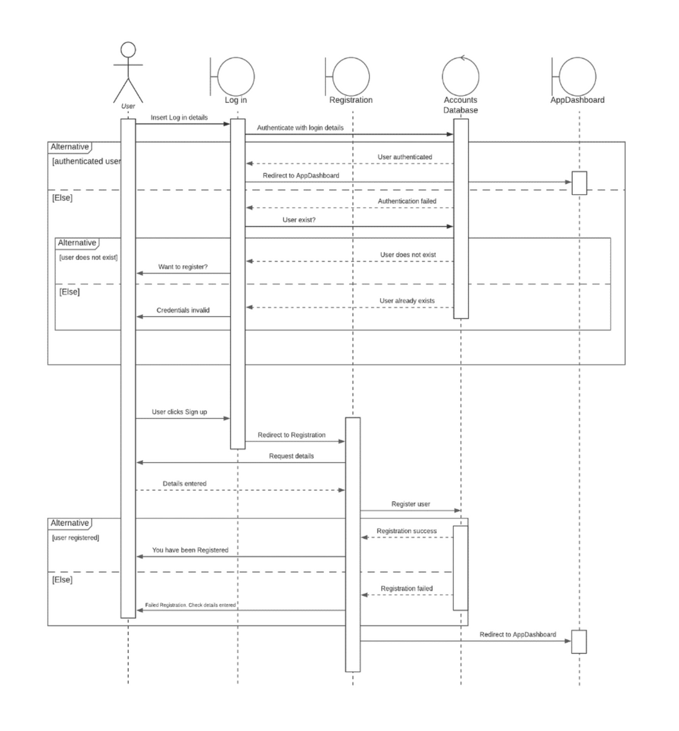
Dynamic model – sequence diagrams
Login and Register.

Slide 17
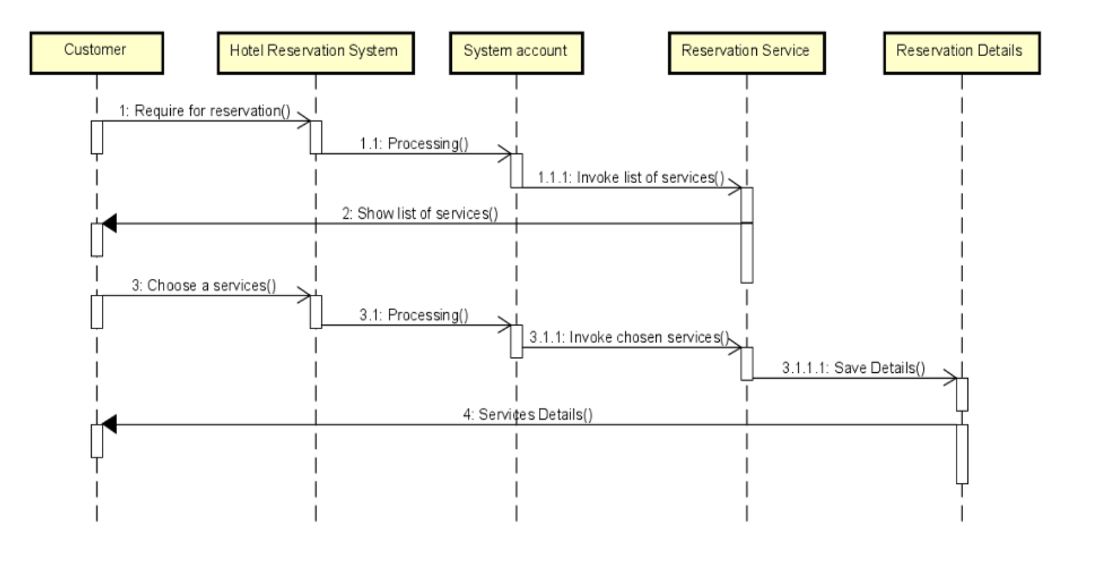
Service

Slide 18
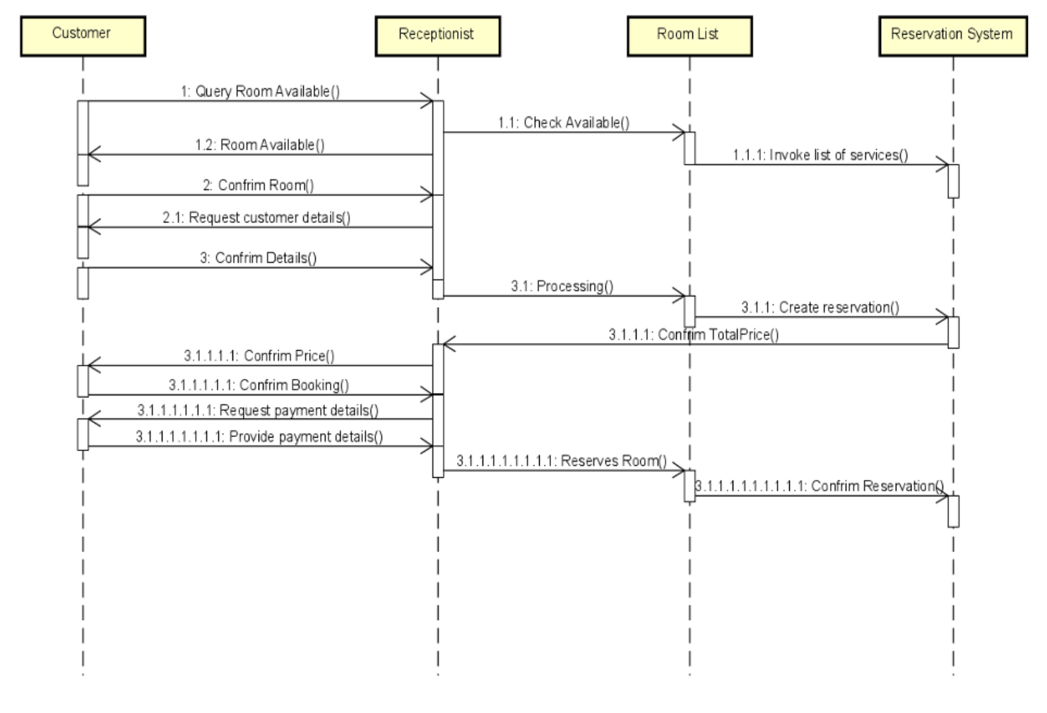
Booking

Slide 19



6. Test Plan
Deciding on the requirements and design of the system
In the early phases of the development process, the team decided it was essential to have a graphic user interface (GUI) for the software. After the sprint involving creating a GUI for the system, it was tested to check if all the tabs were working using a cout test in C#. Display tabs were set to non-editable tabs just to display the information.
Checking for the functionality of XML to get room data and check if the form filters it
Creating a new customer record and storing it using XML
Storing rooms and then using insertion sort to sort them by price
Calculating final bill and customer check-out
The final bill is calculated by multiplying the room’s price per day of stay by the amount of days the guest stayed. After the member of staff receives the payment from the customer, they click on the check-out button which should set the room status back to available and set the guest Id and number of guests back to zero.
After inputting constant data for the rooms like cost and availability were called in the system using XML, they were tested in the GUI to display rooms by their type displaying all the room numbers for that type and their availability status. By selecting the type of room on the combo box in the GUI and clicking filter, the system displayed all the available rooms of that type.
After adding parts in the GUI for adding a new customer record by inputting customer details and generating an ID for the customer. The customer record was then stored in the system data using XML and checked if a new current customer was created in the customers sections of the GUI for that customer which is then used to pick the customer and make the booking for the previously selected room.
The rooms can be stored in an array because their room number and details never change because they are already built in the hotel, which makes it easier to sort the rooms by their price from low to high or vice-versa.

Slide 20
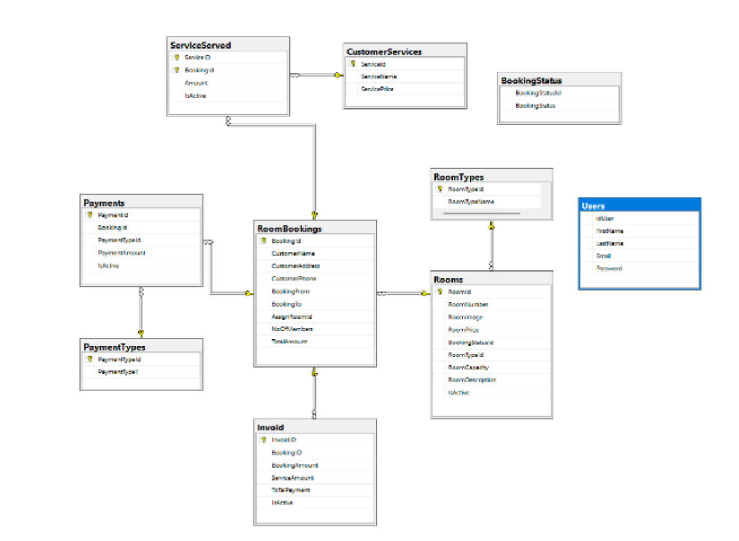
Demo
Database

Slide 21
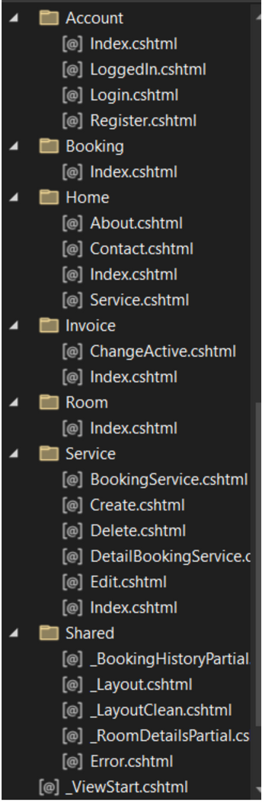
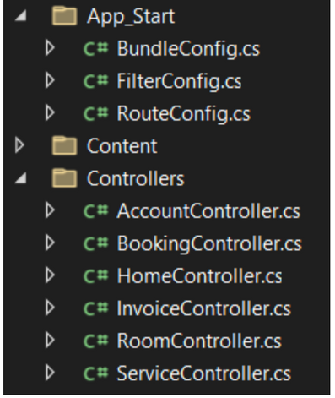
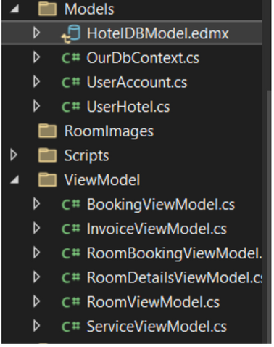
Demo
Source code
structure of files.

Slide 22
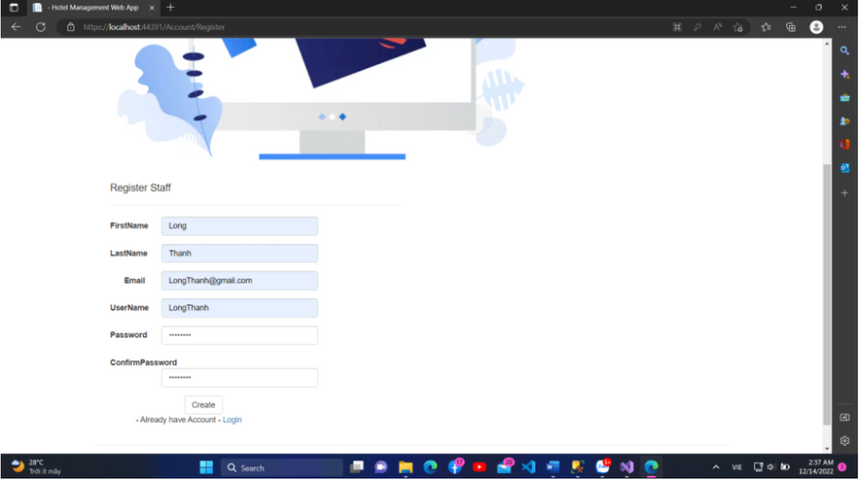
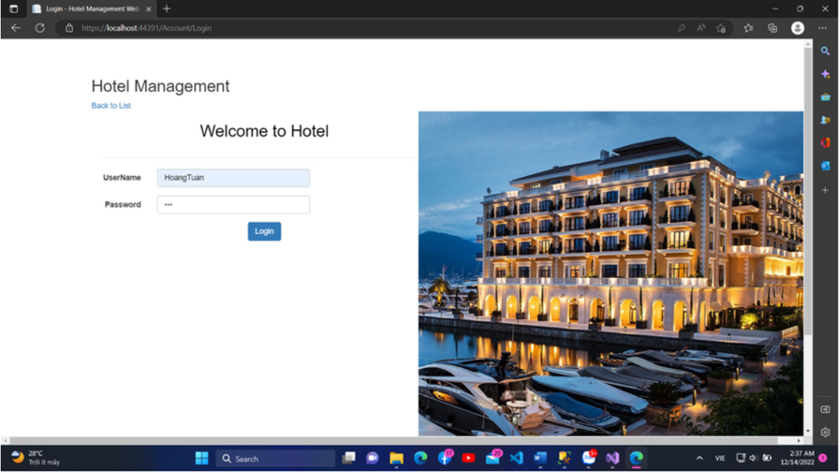
Function
Register
Login

Slide 23
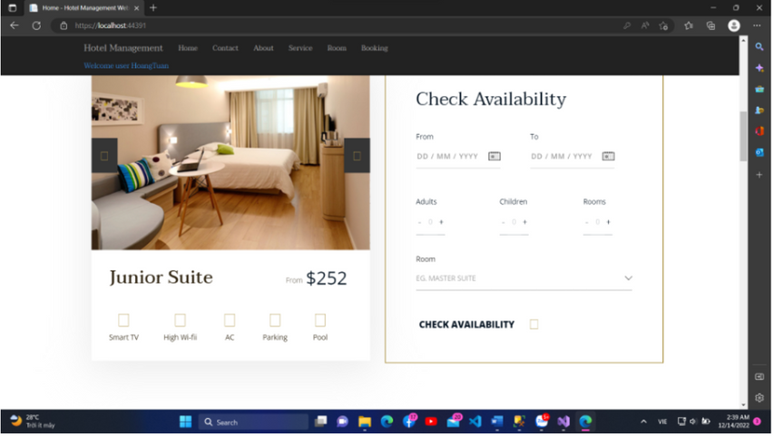
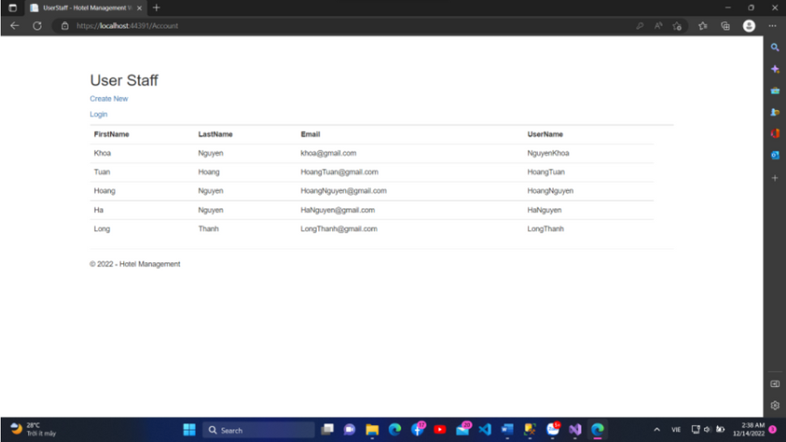
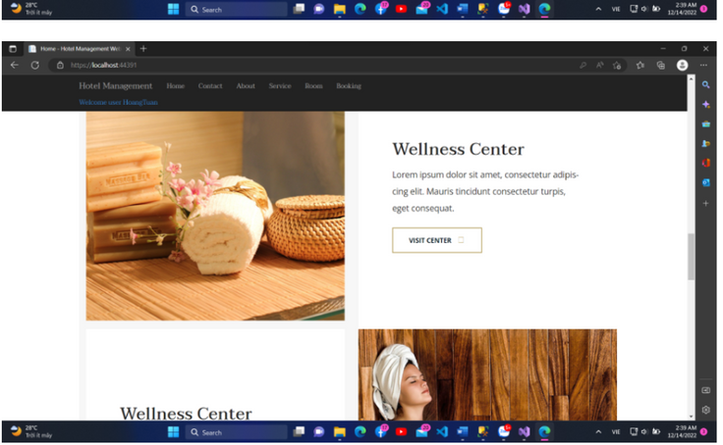
Function
List of User
Home

Slide 24
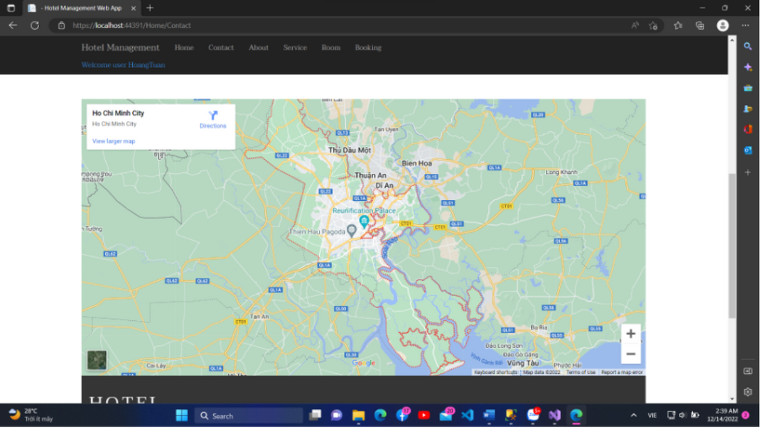
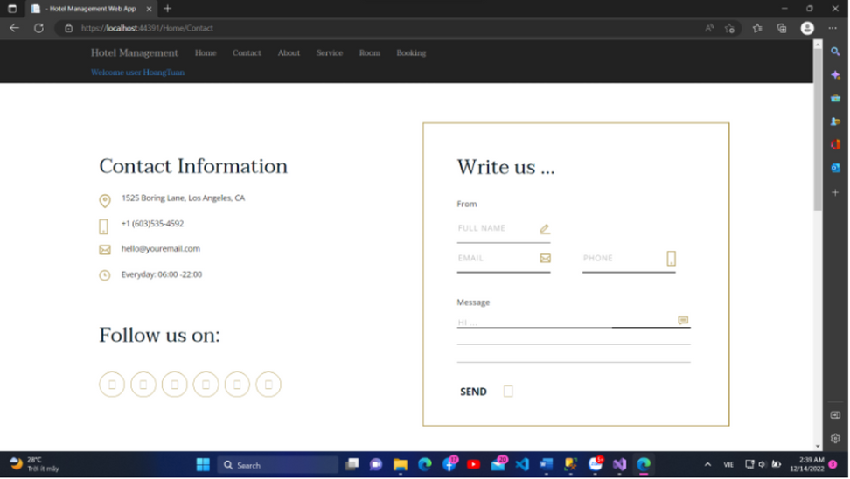
Function
Contact with map API

Slide 25
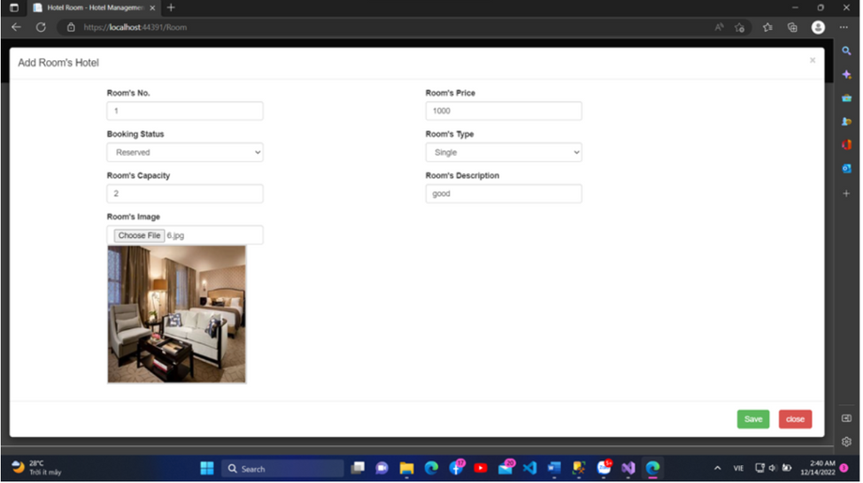
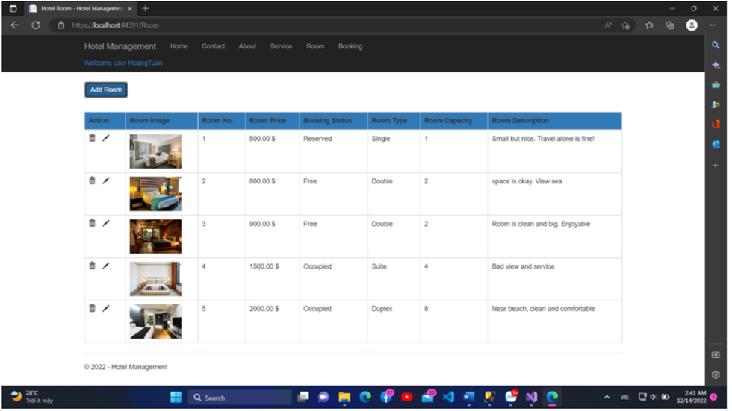
Function
Add Room
Show List Of Room

Slide 26
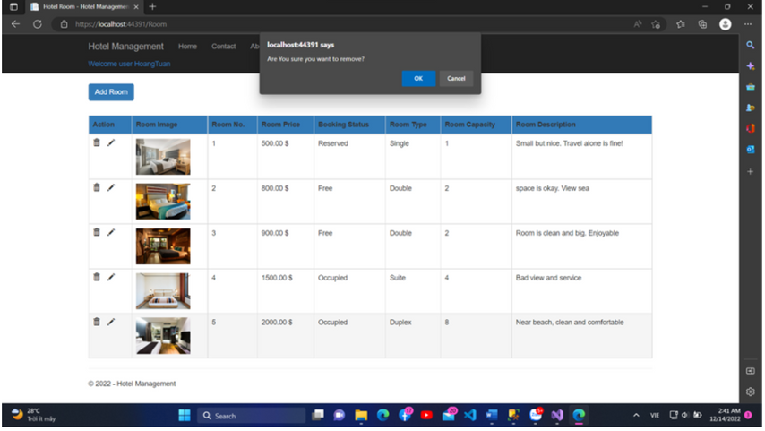
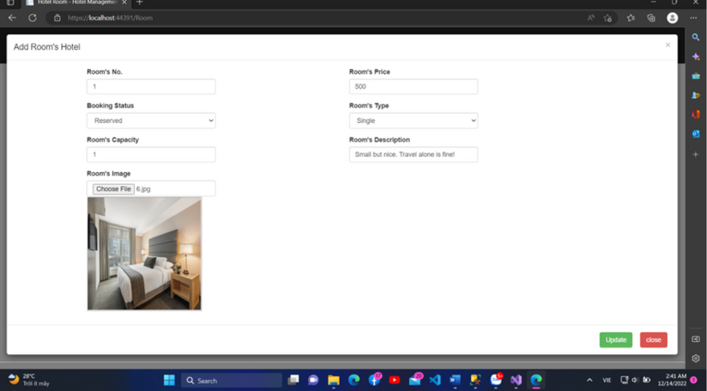
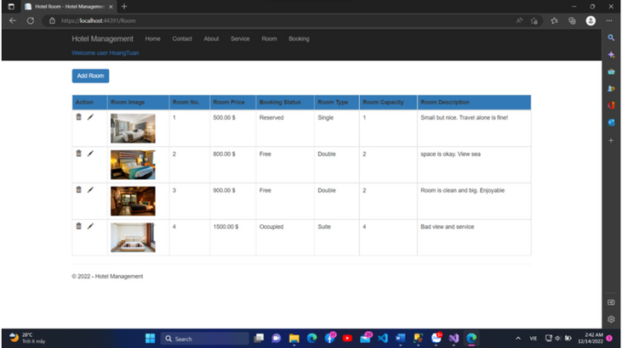
Function
Update Room
Remove Room

Slide 27
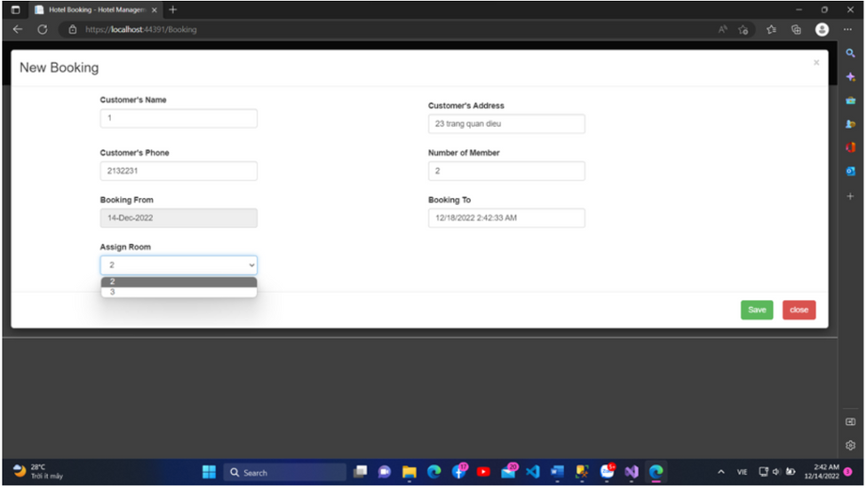
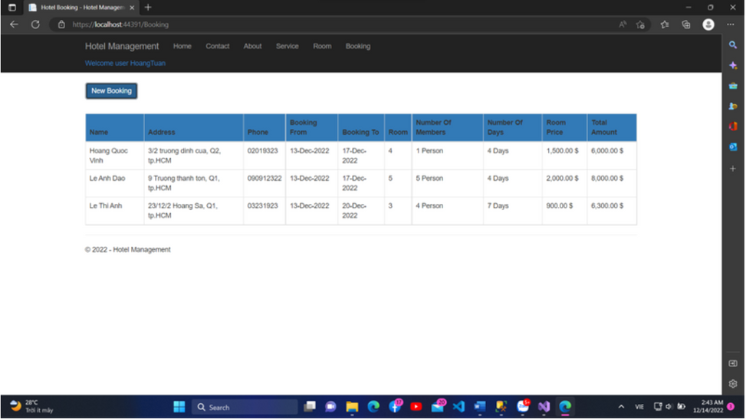
Function
Booking Available Room
Show List Booking With Total To Pay

Slide 28
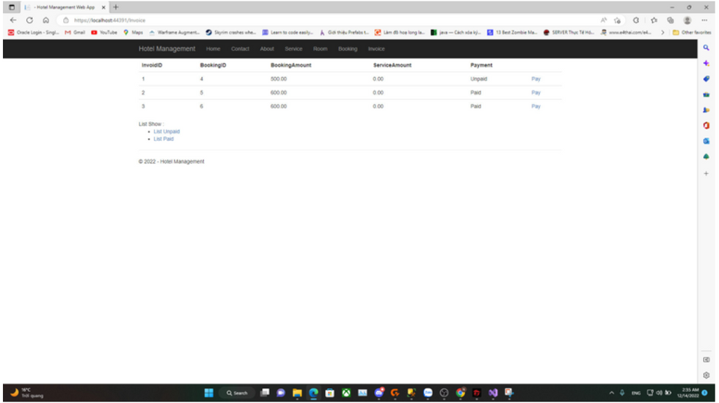
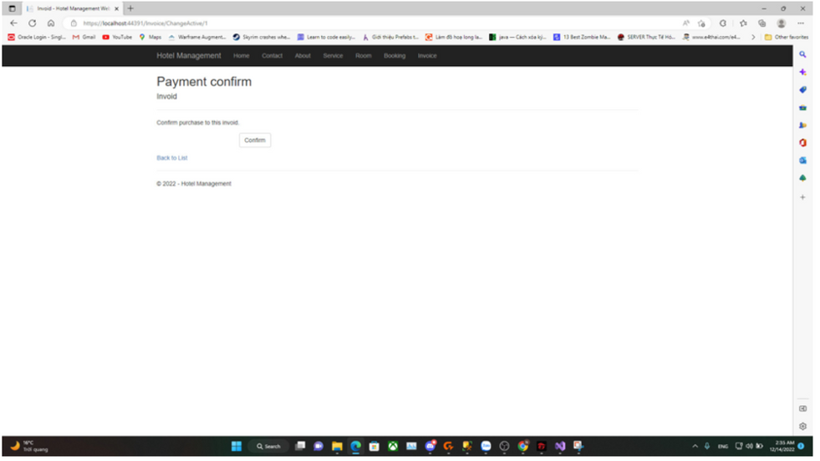
Function
Payment

Slide 29
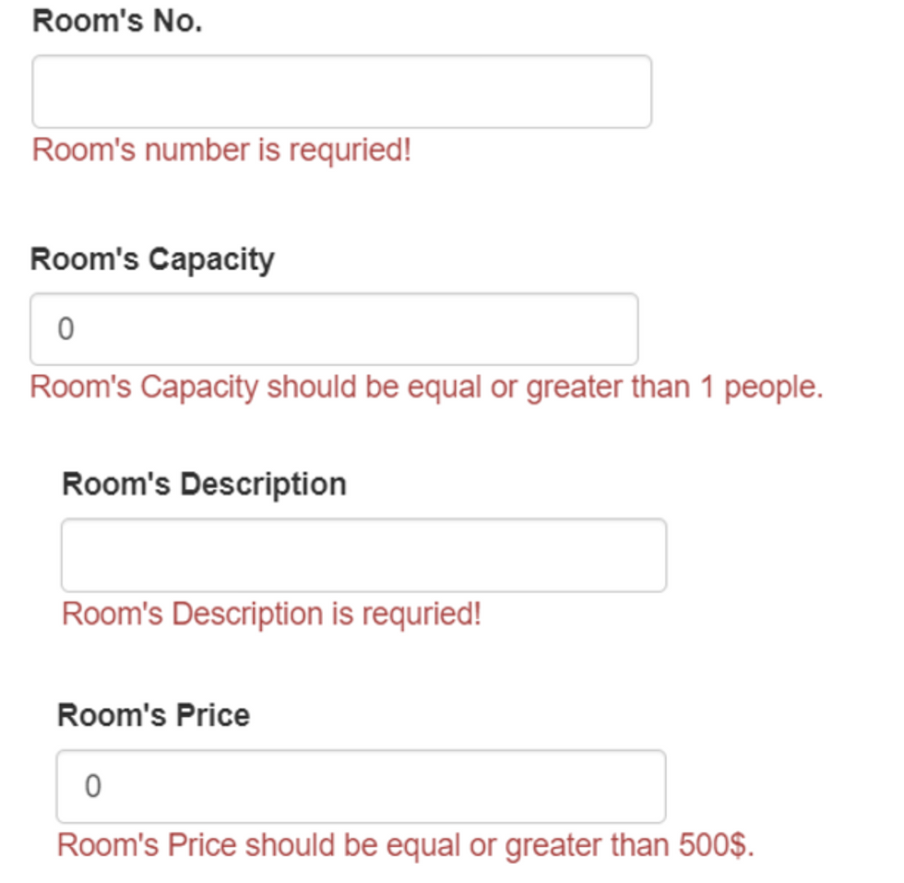
Testing
Test case for AddRoom().
All fields must not be null.
Room’s Capacity must be greater than 1 less than 10 person.
Room’s Price must be equal or greater than 500$

Slide 30
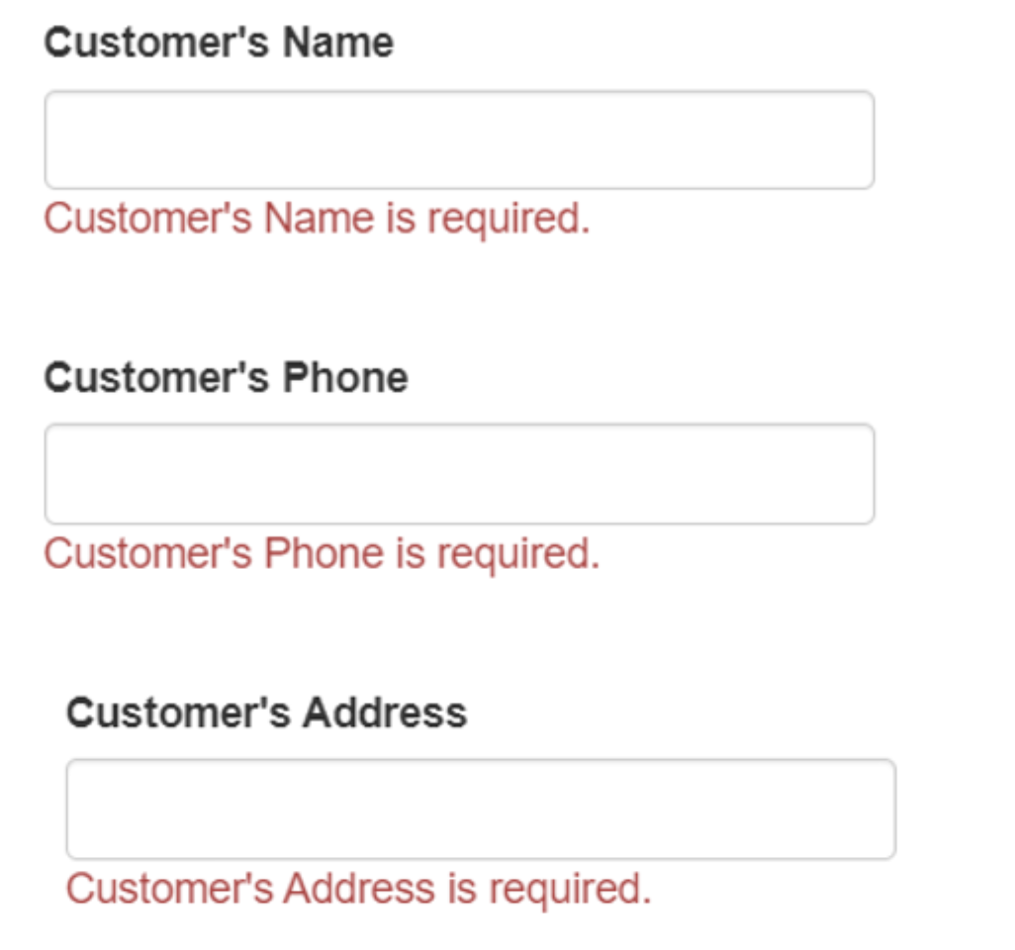
Testing
Test case for AddBooking().
All fields must not be null.

Slide 31
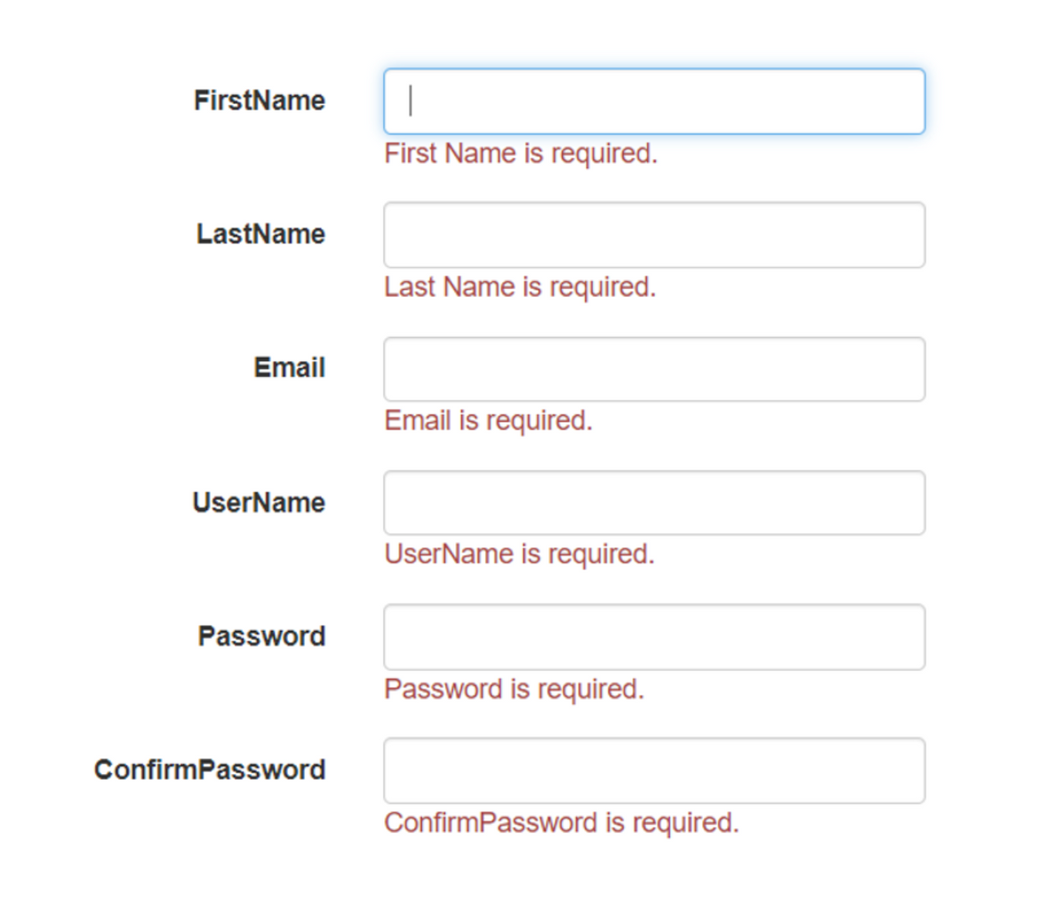
Testing
Test case for Register().
All fields must not be null.

Slide 32
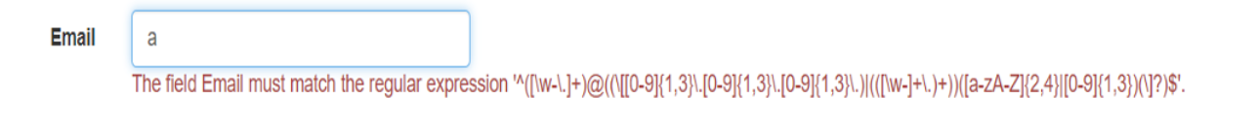
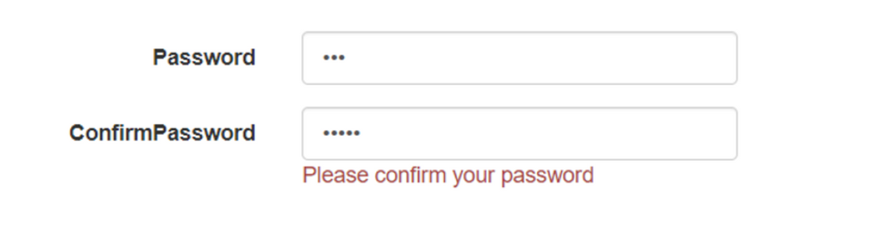
Testing
Email must match the regular expression
Password and confirmPassword have to be matched.

Slide 33
GROUP 08
THANK YOU

